Slide 1
variables
- jeevitha r

Slide 2


Slide 3
Variables:
What is Variable?
Variable is a piece of memory that can contain a data value.
They are typically used to store information which your Java program needs to do its job.
Declaring Variable:
data_type variable_name=value;
Eg :- int num=2;

Slide 4
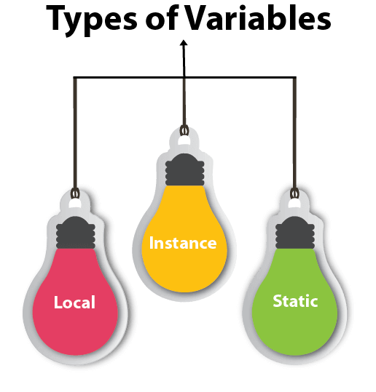
Variable types

Slide 5
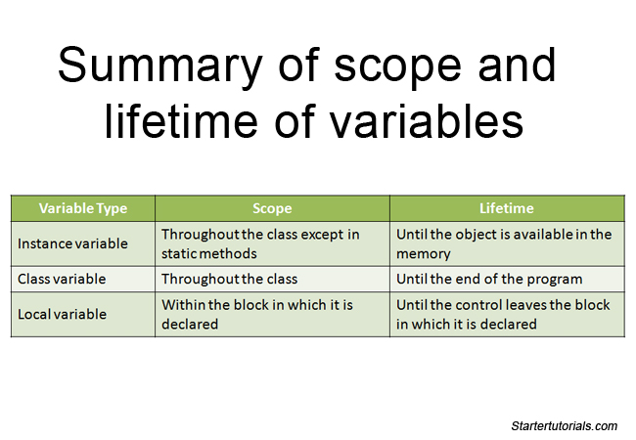

Slide 6
Local variable :
Declared inside the method and constructor.
Eg :-
public static void main(String[] args) {
int i; i = 0;
System.out.println("i is " + i);
}

Slide 7
Instance variable :
Declared inside the class but outside the method.
Eg :-
public class Foo {
public void bar() {
System.out.println("I'm an instance method");
} }

Slide 8
Static variable :
Declared as static is called static variable inside the class.
Ex :-
class Test{
static {
//Code goes here
} }

Slide 9
THANKYOU

